Slide 1

Flutter ui kit
Tadas Petra
Developer Evangelist, Agora

Slide 2
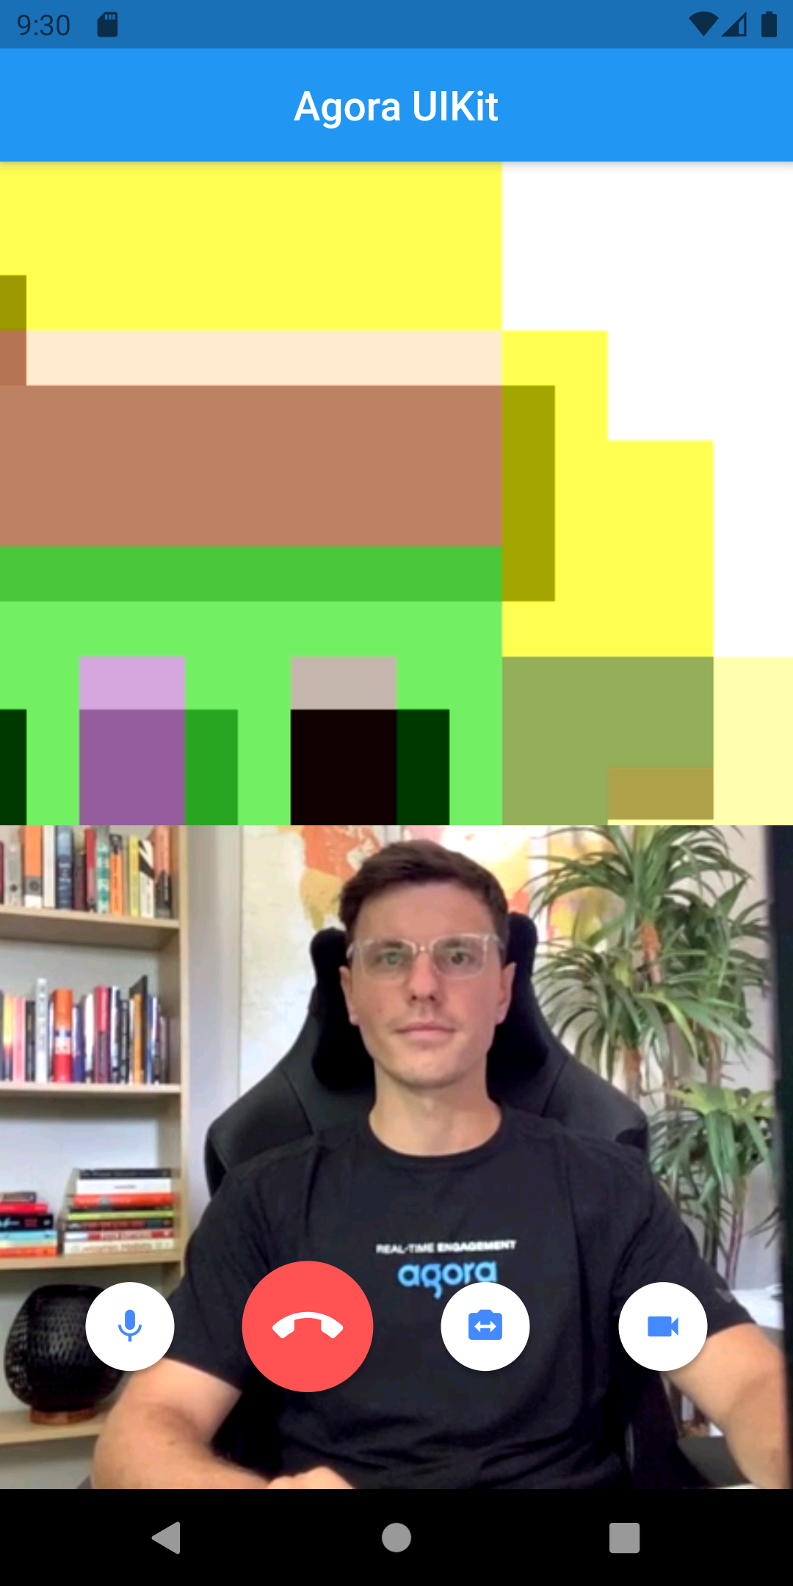
Basic ui kit

Slide 3
Layout customization
Grid & Floating Layouts
Customizable Floating Layout
Change Disabled Video Widget
Audio and Video States
Number of Users Counter

Slide 4
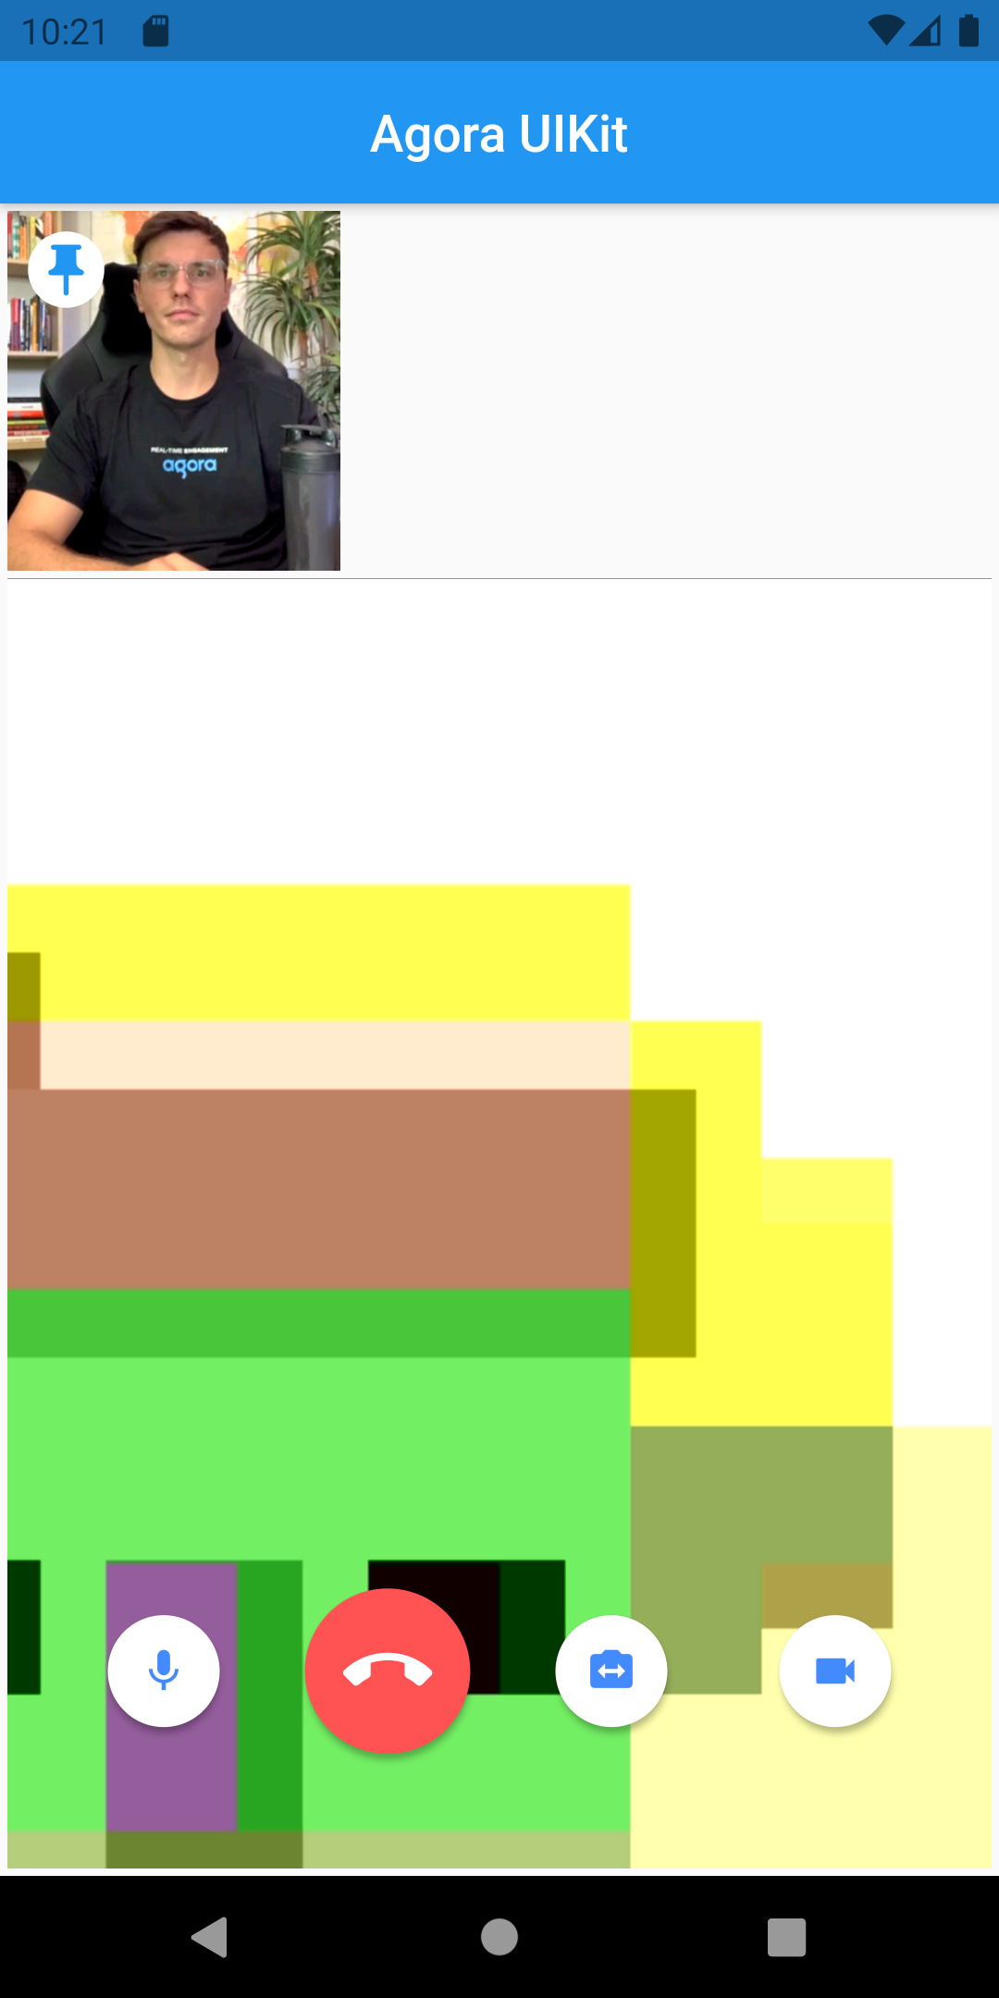
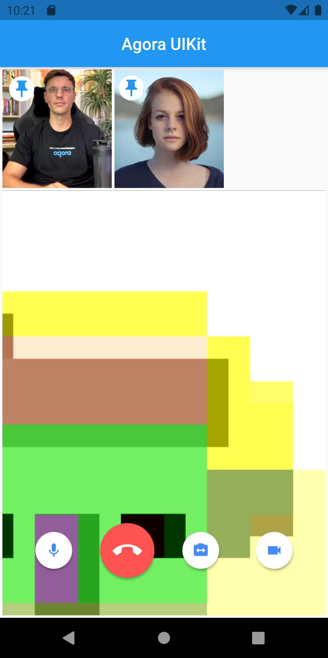
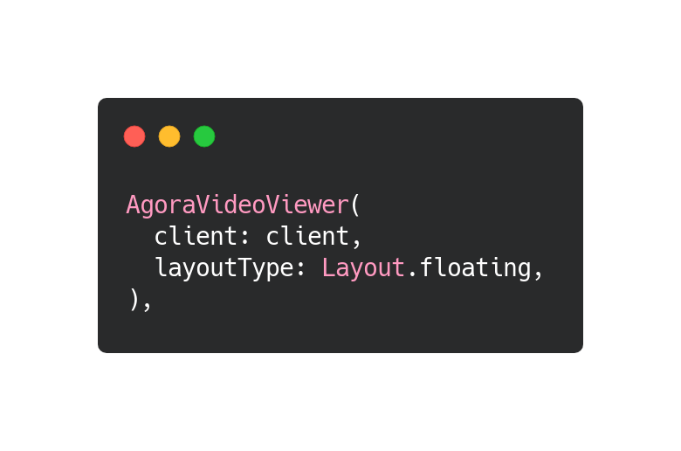
Floating Layout

Slide 5
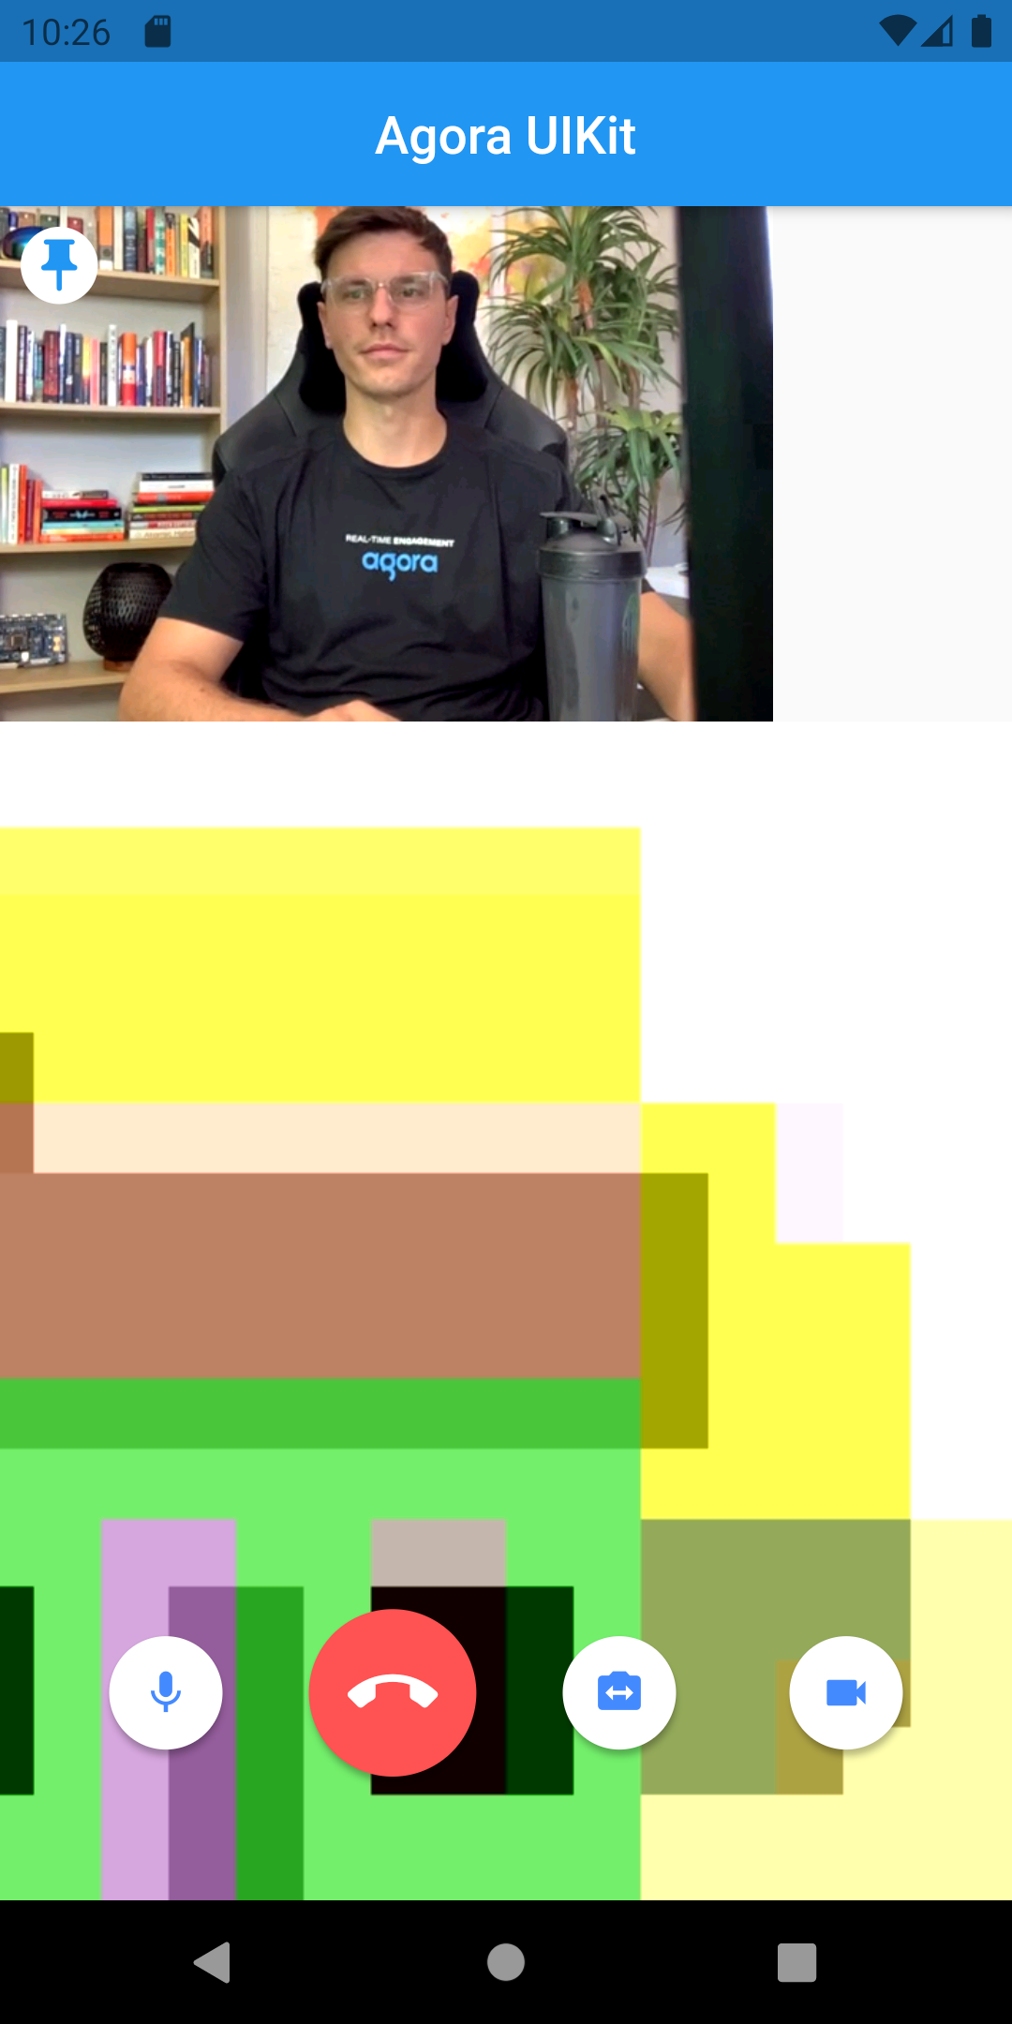
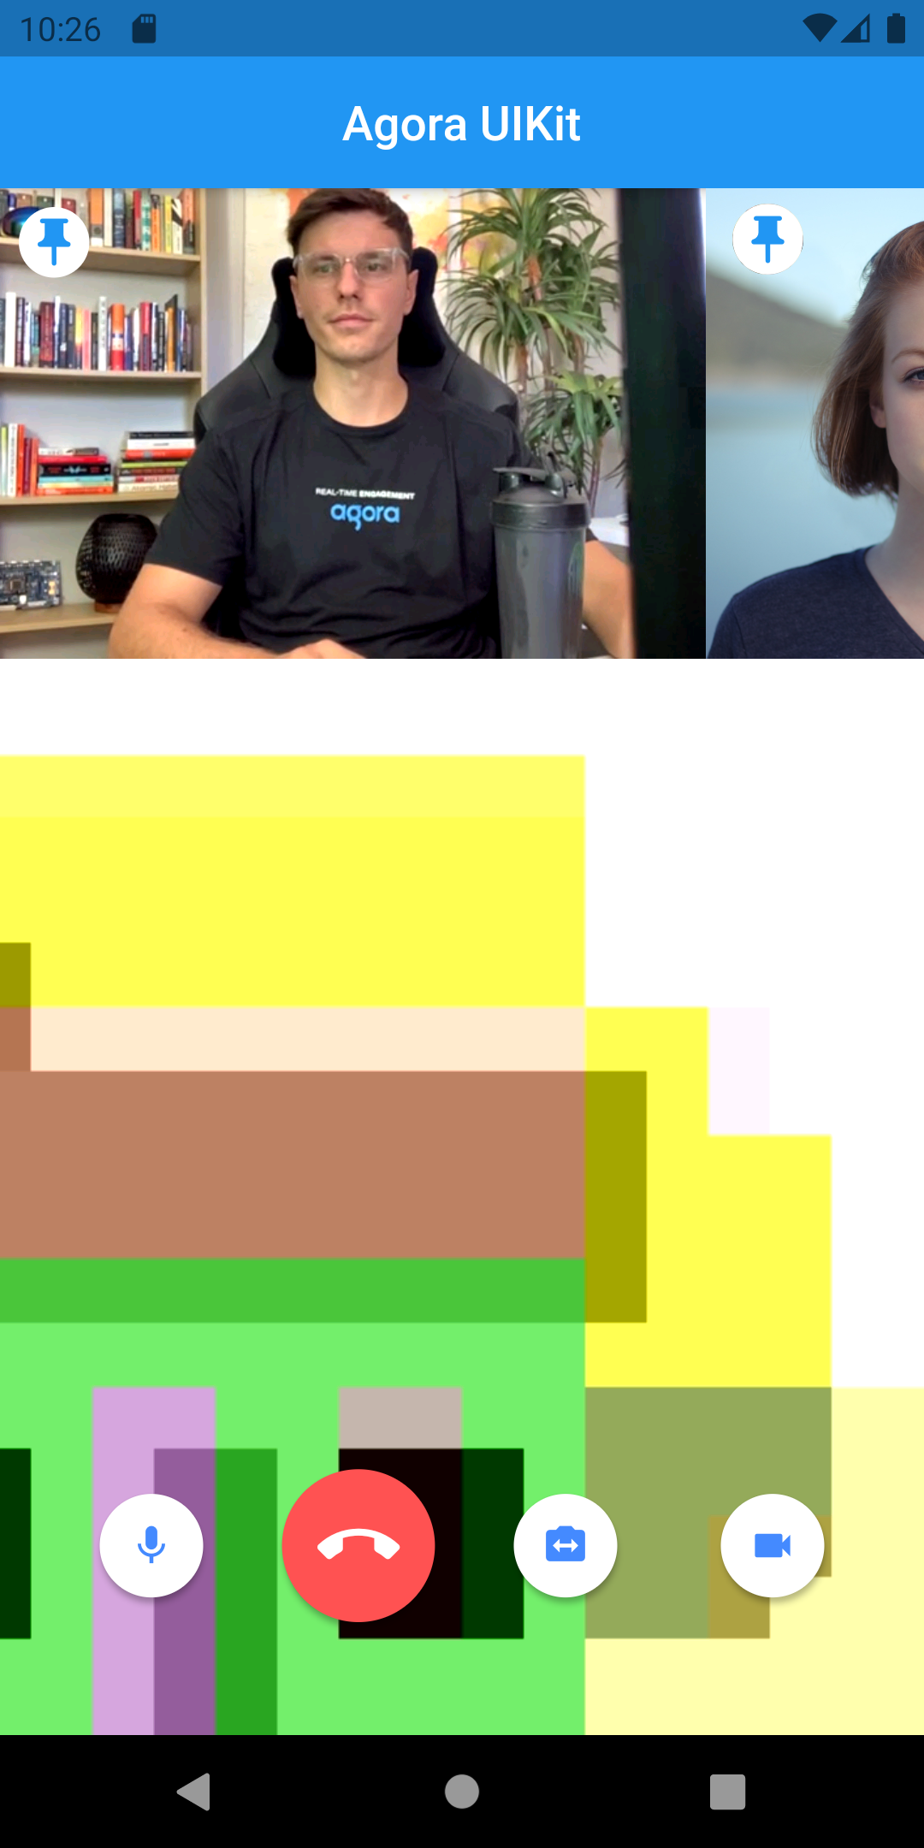
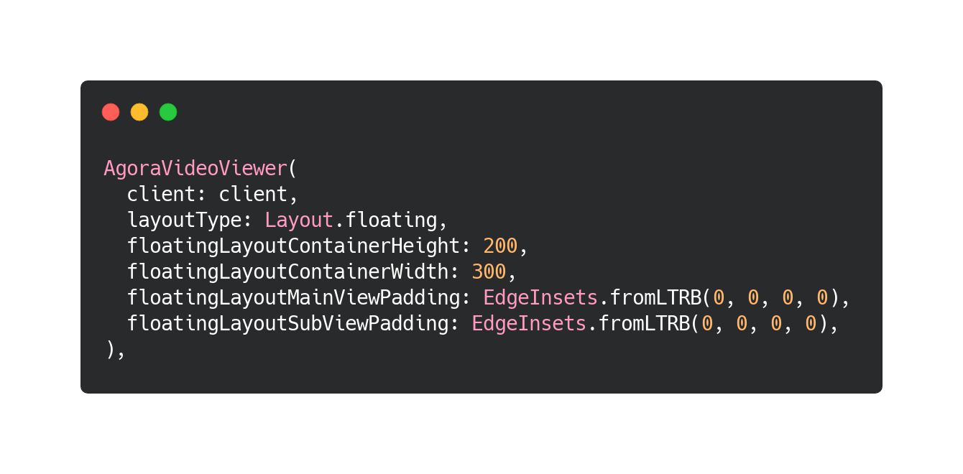
Customize your layout
Before
After

Slide 6
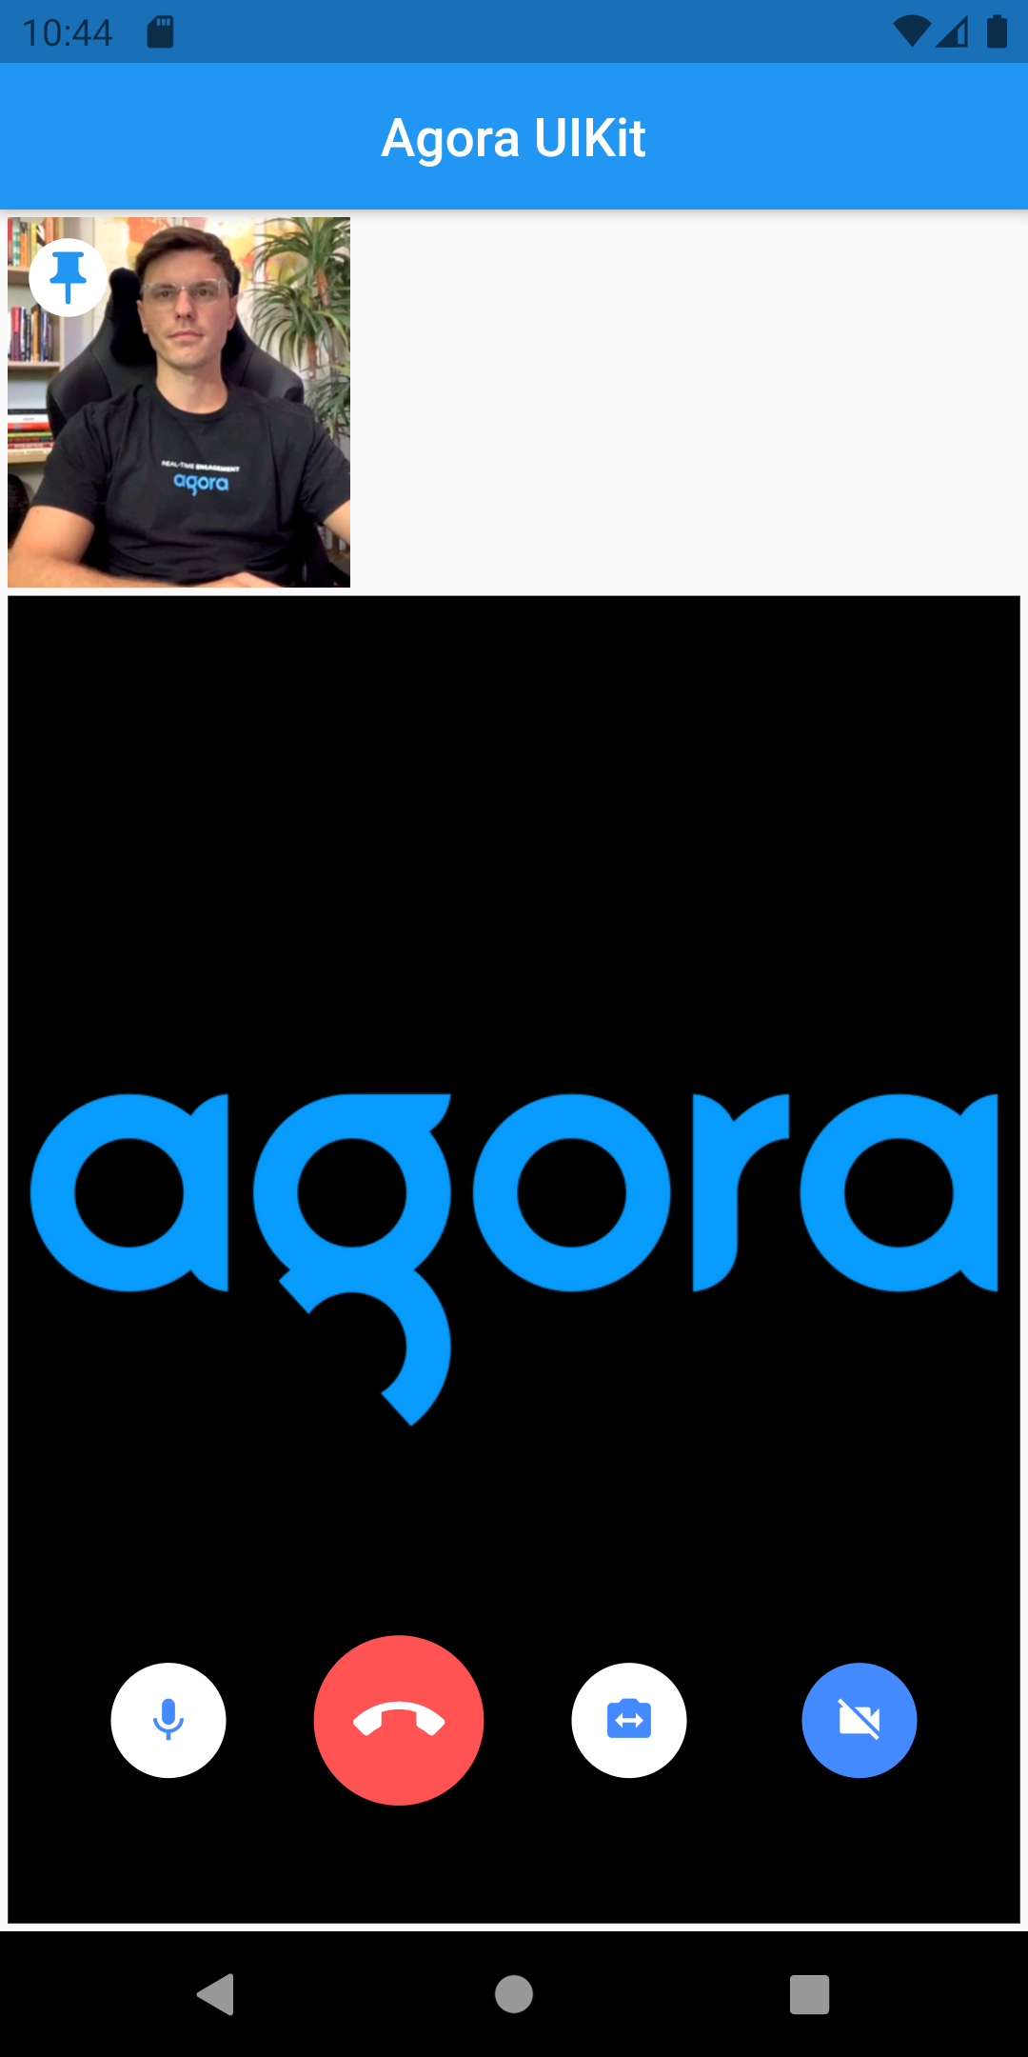
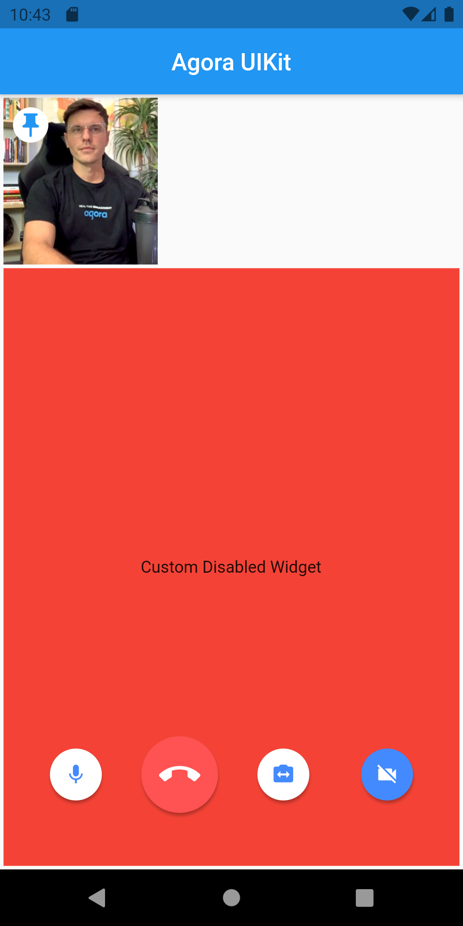
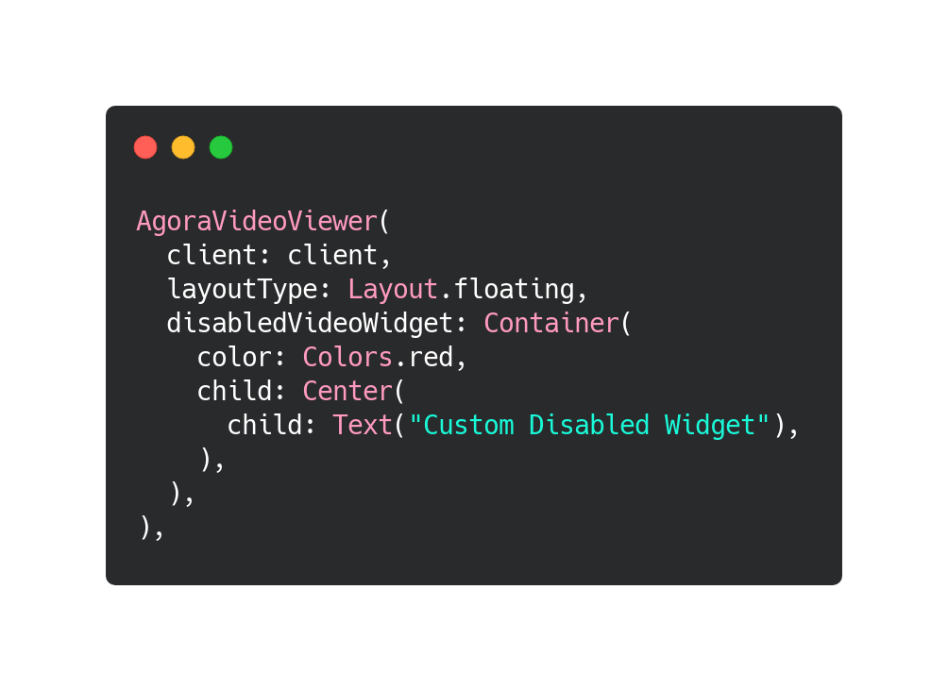
Disabled Widget
Before
After

Slide 7
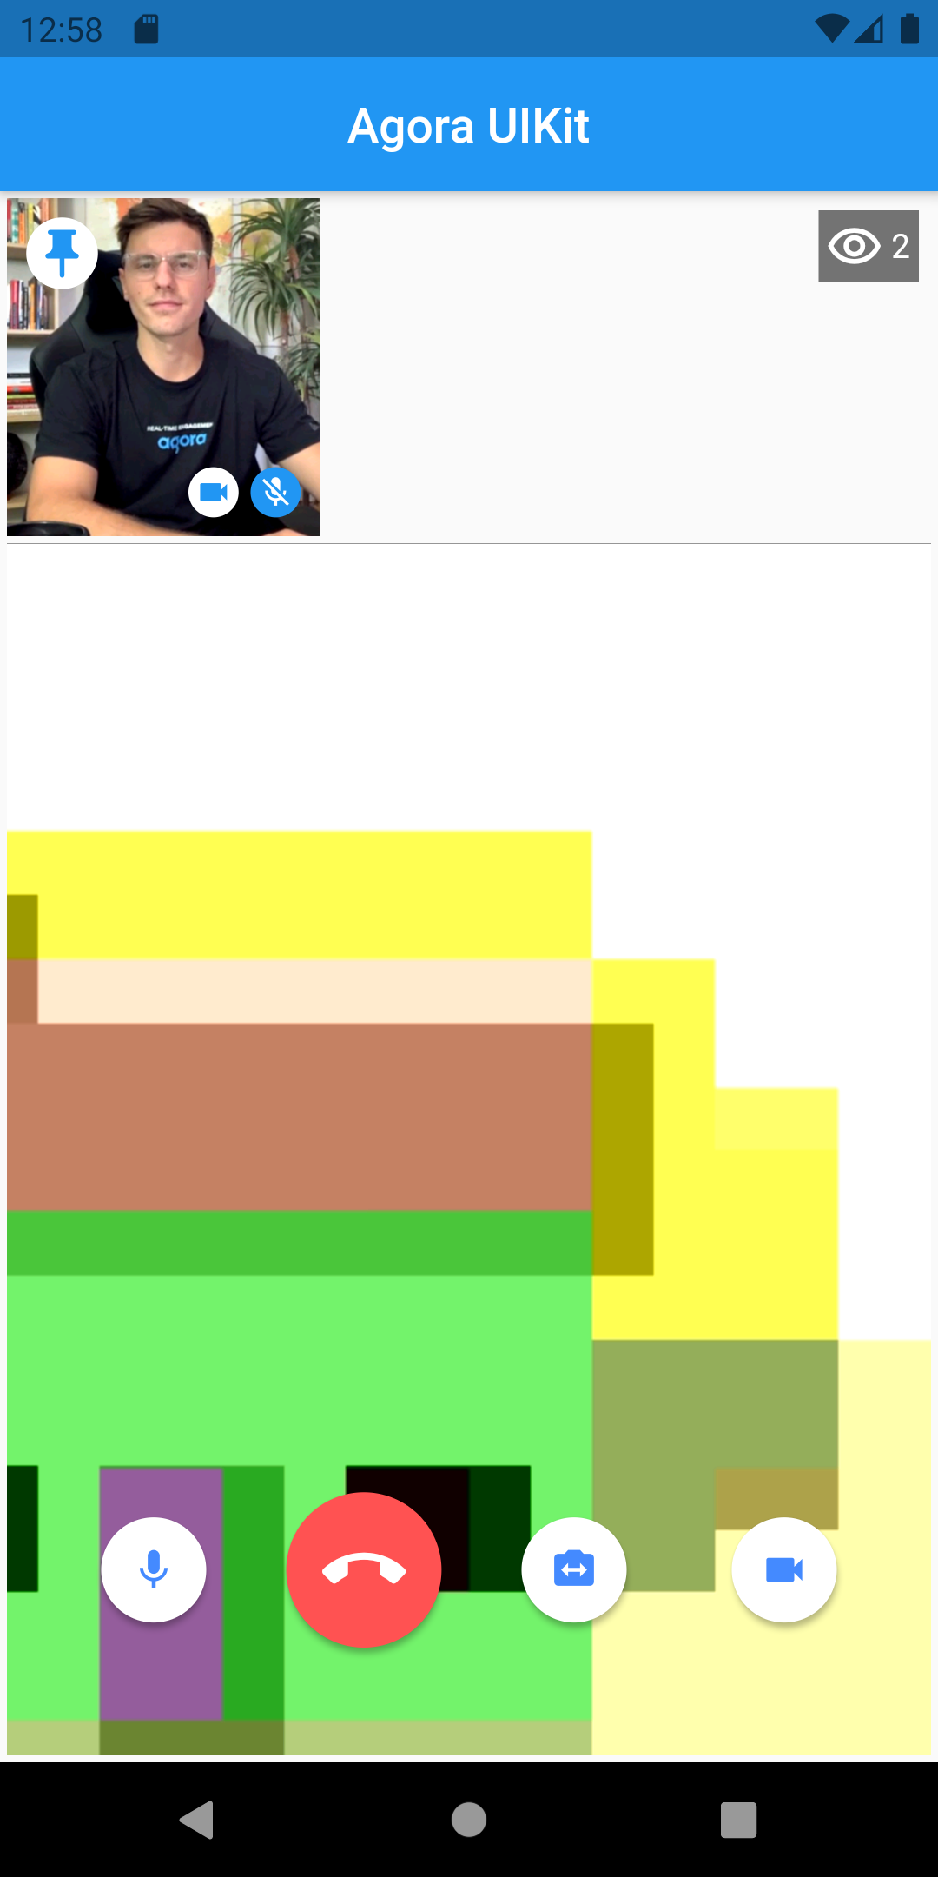
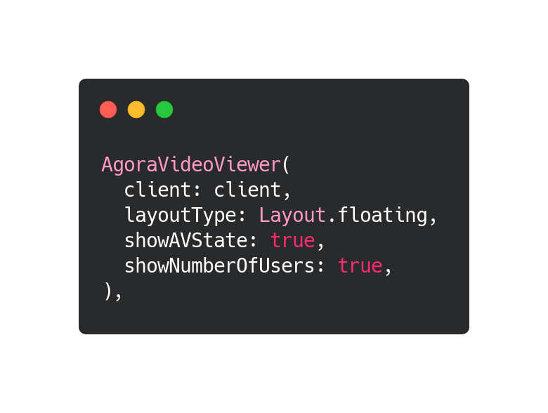
AV state & Number of users
Before
After

Slide 8
Button customization
Remove or Reorder Buttons
Customize Available Buttons
Add New Buttons
Change Alignment
Change Paddings
Auto Hide Buttons

Slide 9
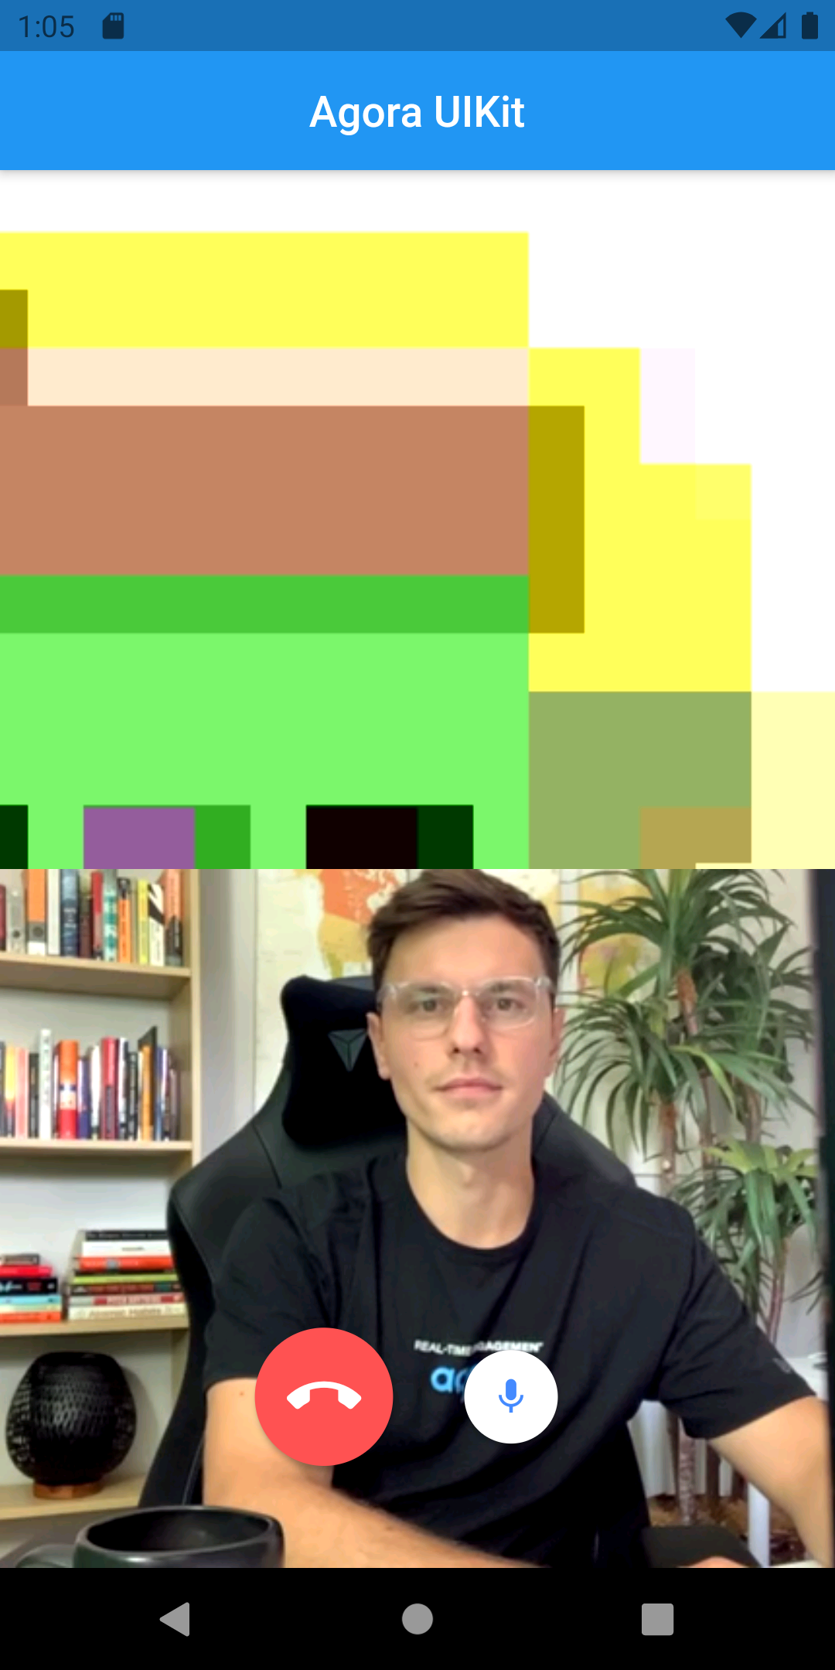
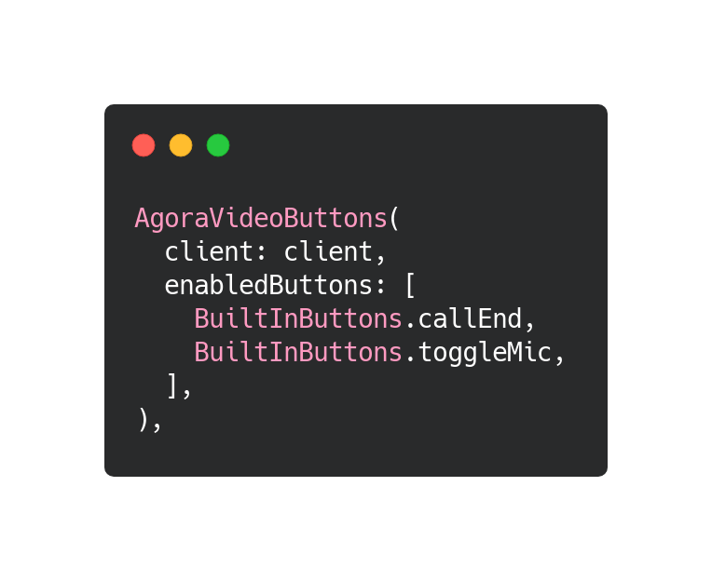
Remove or reorder buttons
Before
After

Slide 10
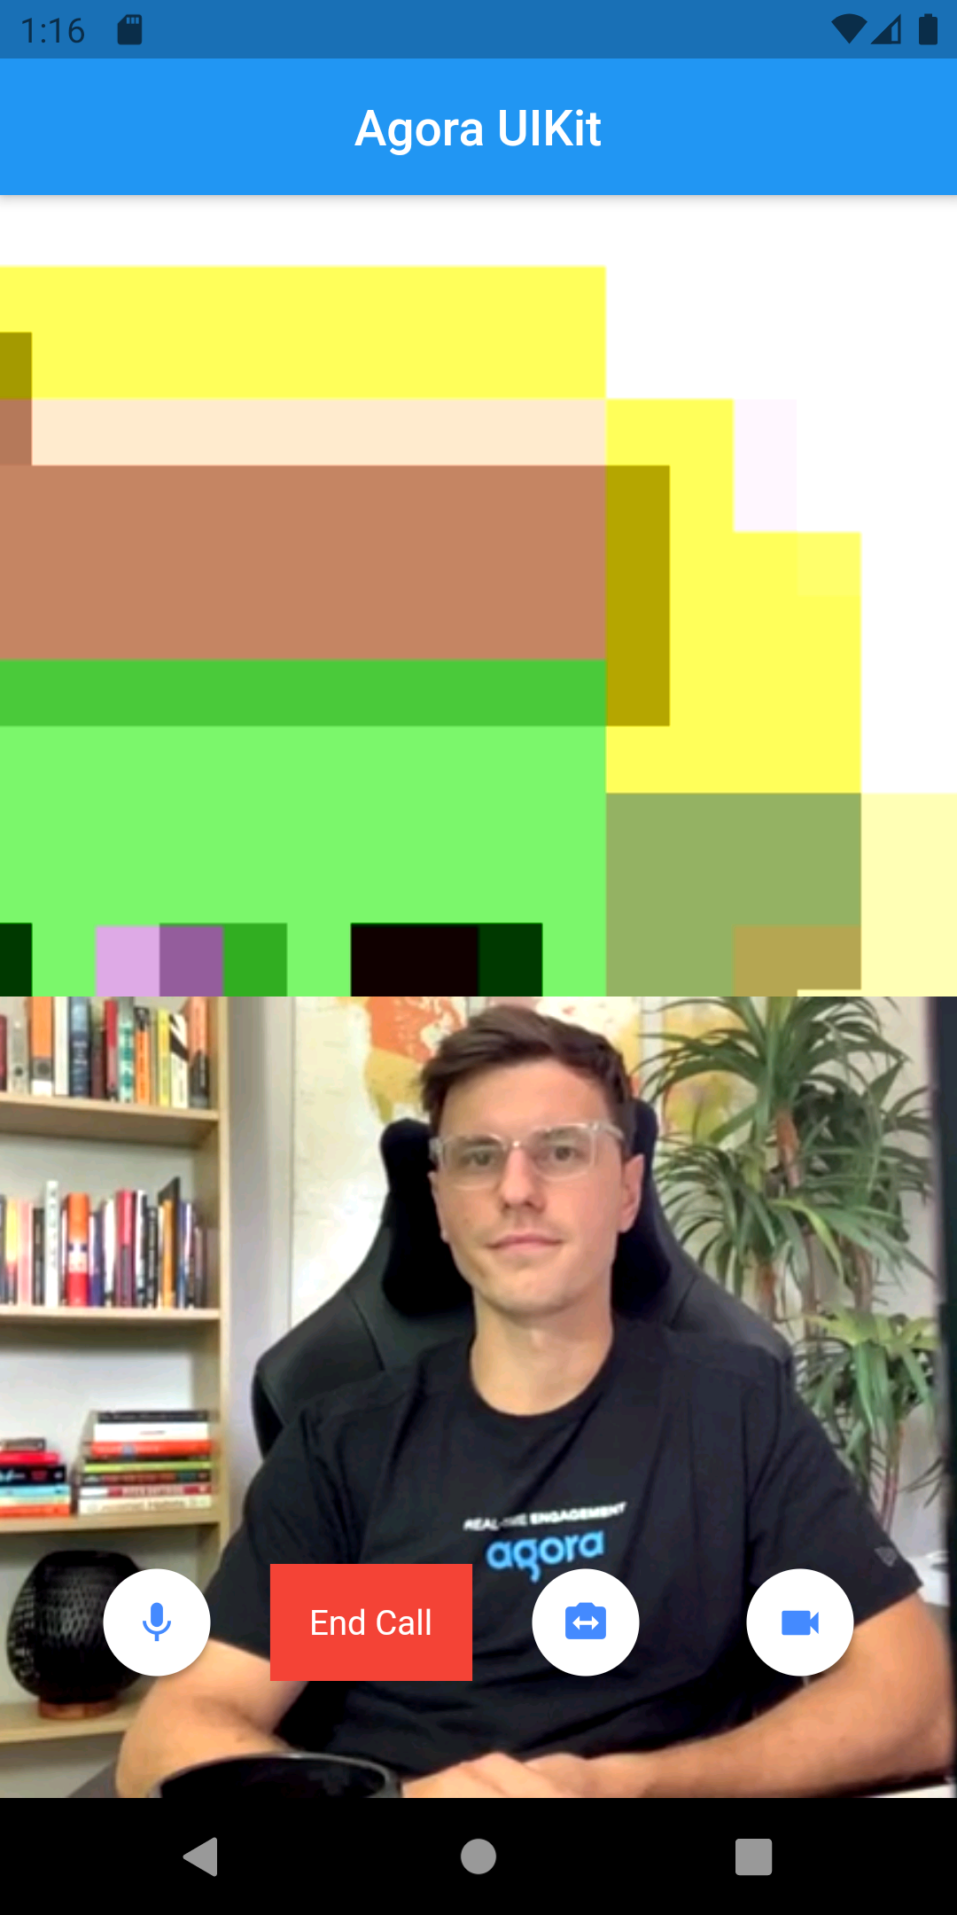
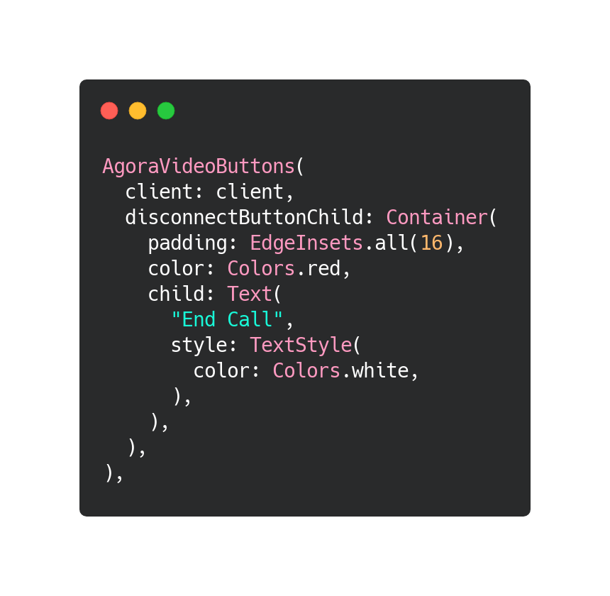
Customize buttons
Before
After

Slide 11
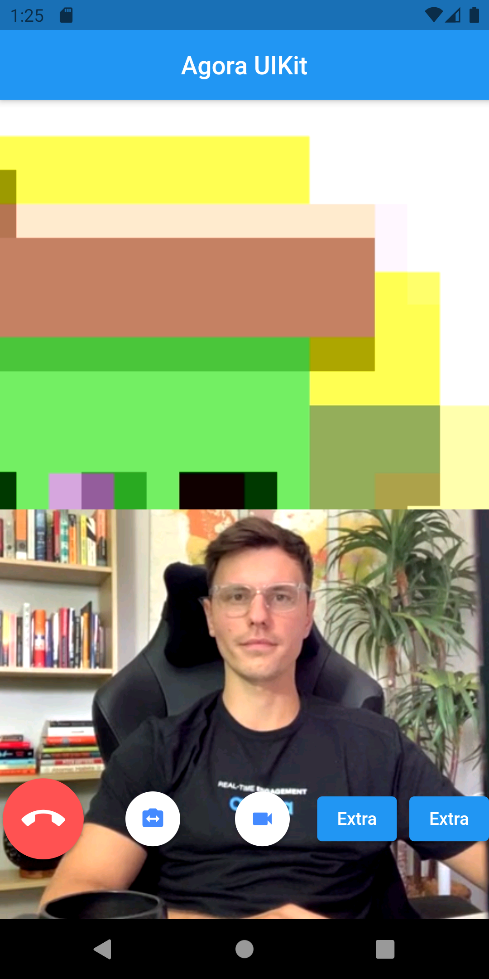
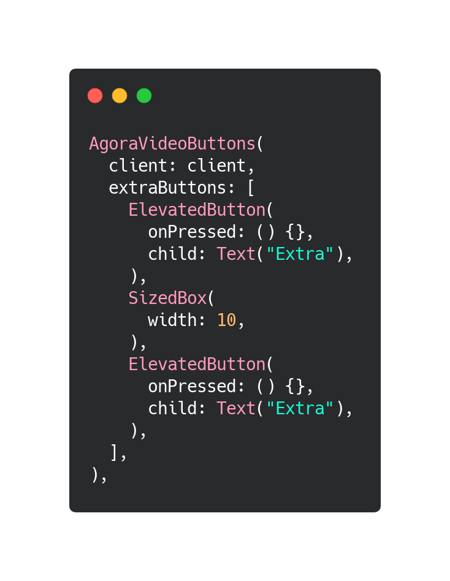
ADD Buttons
Before
After

Slide 12
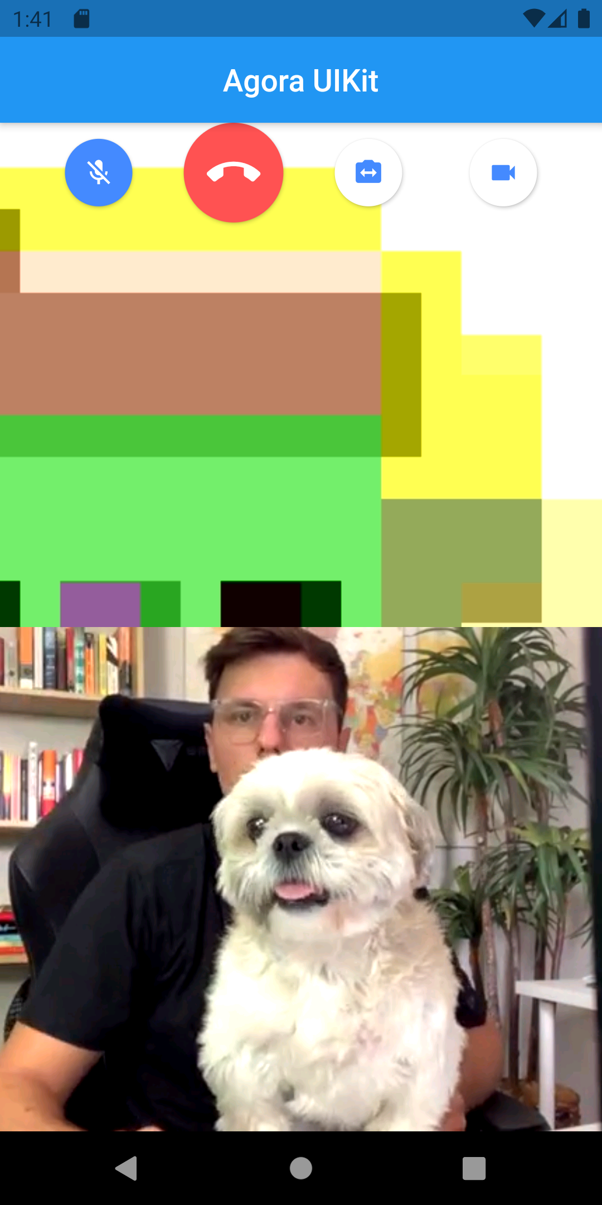
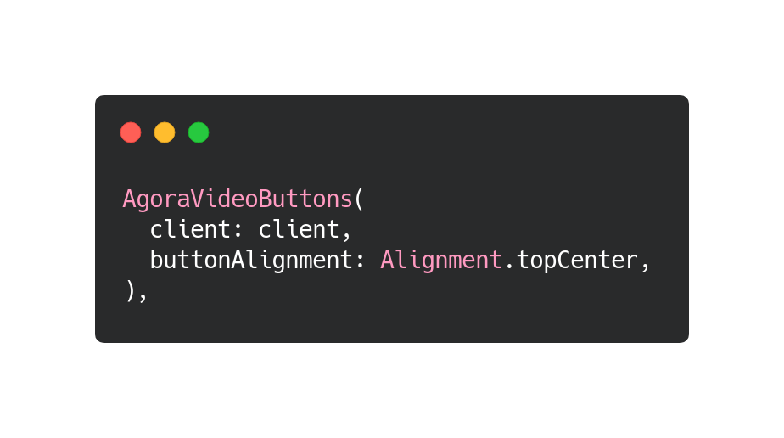
Align buttons
Before
After

Slide 13
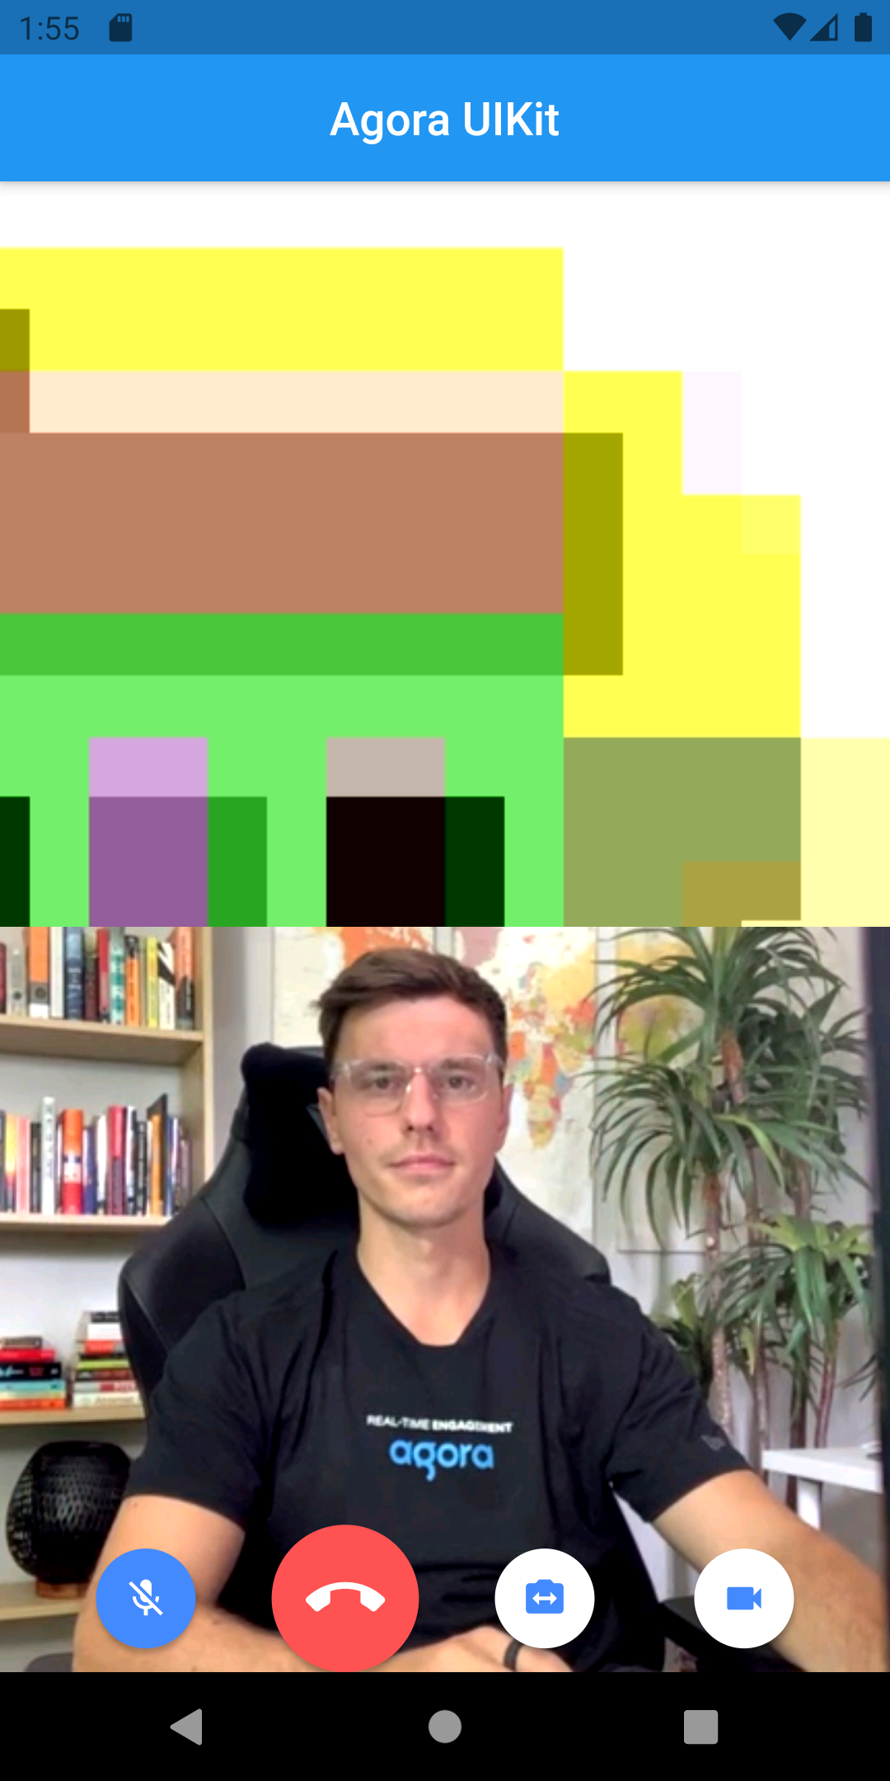
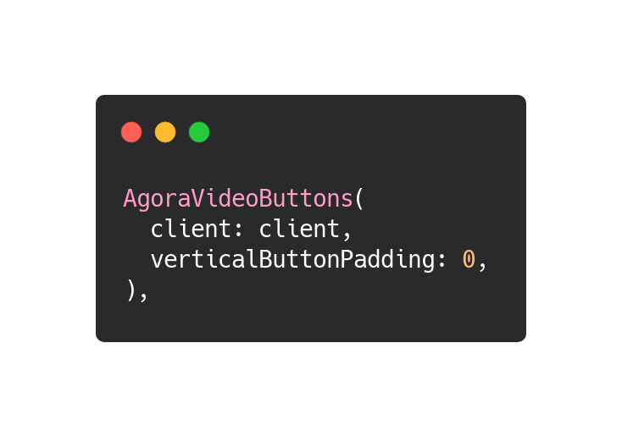
Button Padding
Before
After

Slide 14
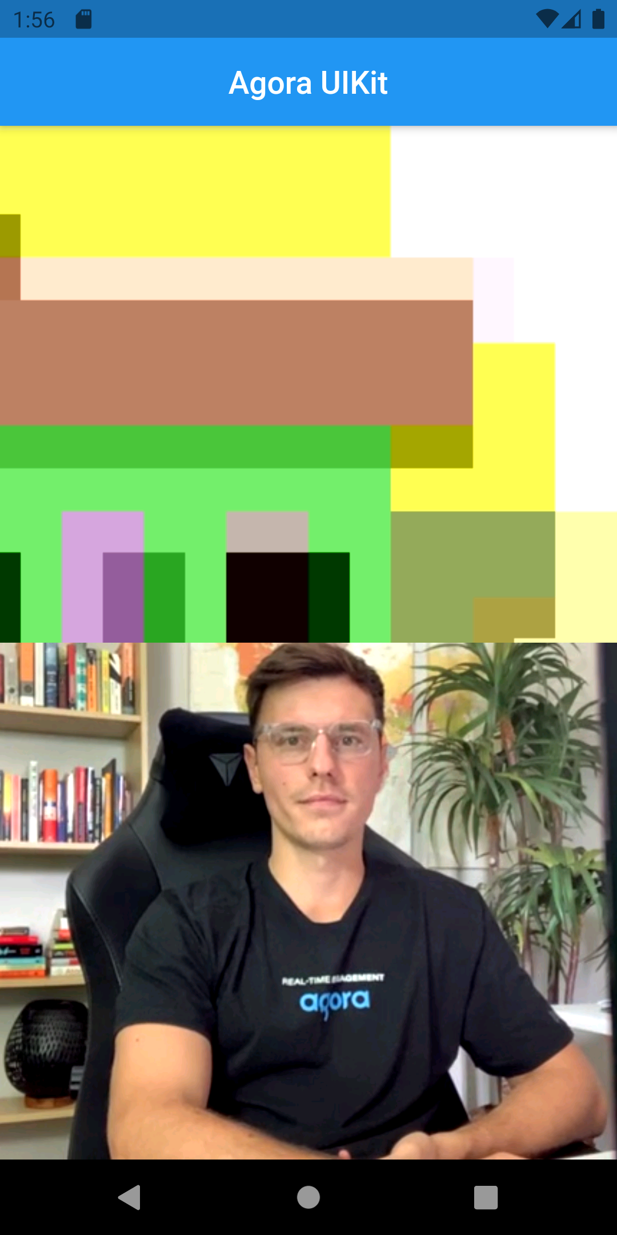
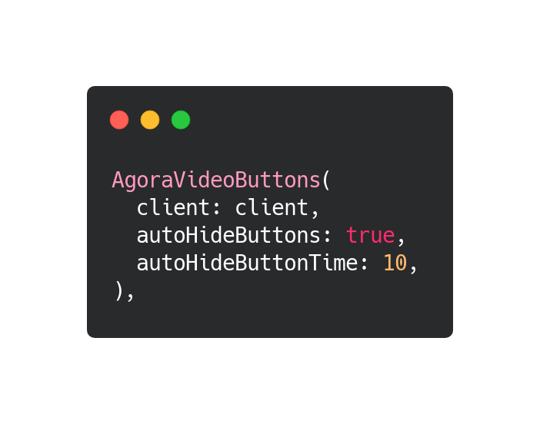
Auto Hide Buttons
Before
After 10s

Slide 15
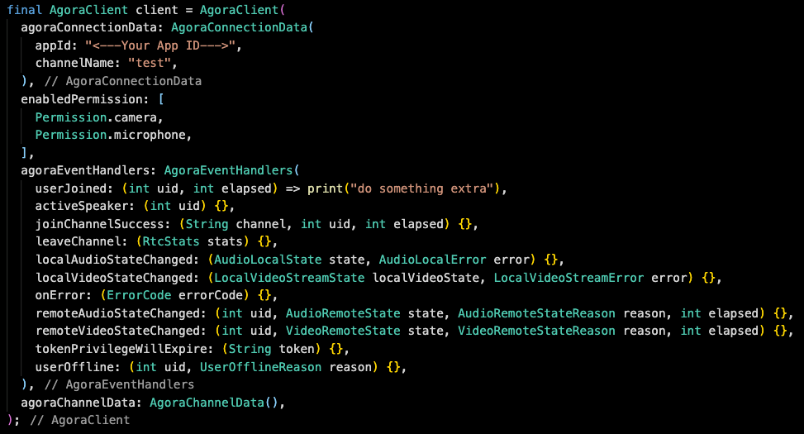
Configure Your call

Slide 16
AGORACOnnectionData
Information for connecting to the call
appId
channelName
uid
tokenUrl
tempToken
areaCode

Slide 17
AGORAChannelData
Customization of the call, can customize it like you would using Core Agora Flutter SDK
isActiveSpeakerDisabled
setCameraTorchOn
setBeautyEffectOptions
channelProfile
clientRole

Slide 18
Thank you
tadas@agora.io
Or
Tadas Petra on Youtube & Twitter

